Slide 1
PUBP309: EDUCATION POLICY
Shivakumar Jolad
FLAME University
Learning Level Crisis: Debates and Perspectives

Slide 2
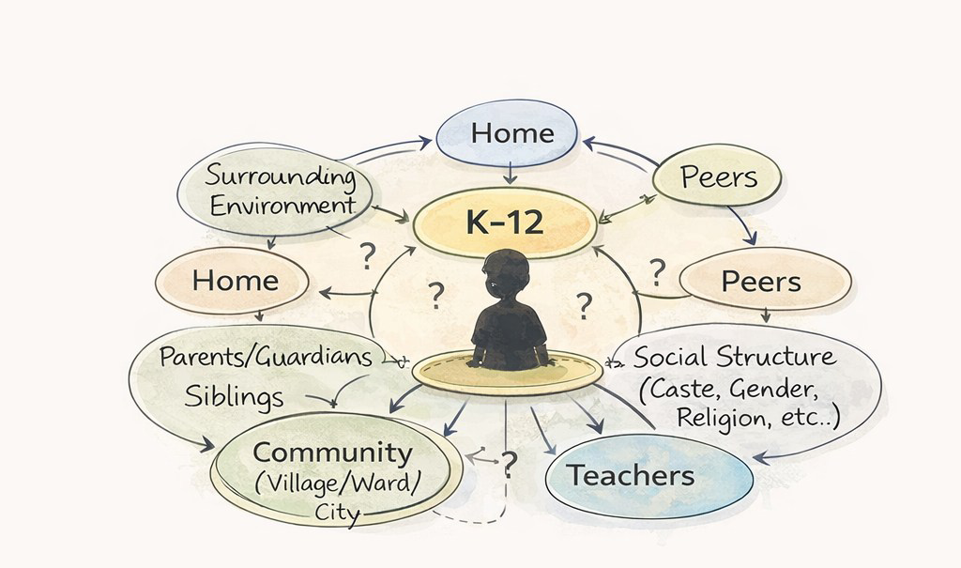
DETERMINANTS OF LEARNING
Who shapes a school learner?
A K–12 child sits inside widening circles — home and siblings, peers, teachers, community, and the social structure of caste, gender and religion.
Proximate → distant determinants
Notes:
Put a K-12 child at the centre. Home, peers, teachers, community and the surrounding social structure all act on whether and how they learn.

Slide 3
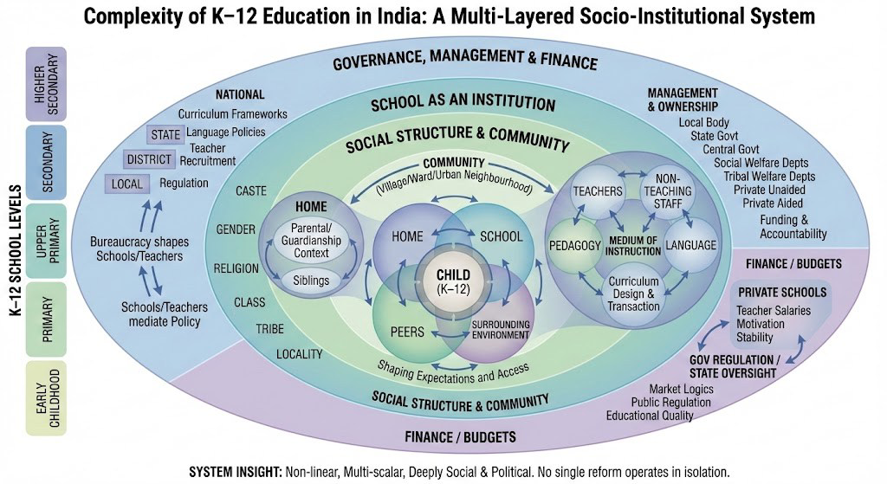
A MULTI-LAYERED SYSTEM
The complexity of school education
Non-linear, multi-scalar, deeply social & political — no single reform works alone.
Notes:
Zoom out and the school system is a multi-layered socio-institutional whole: governance, finance, social structure and community all nest together. No single reform operates in isolation.

Slide 4
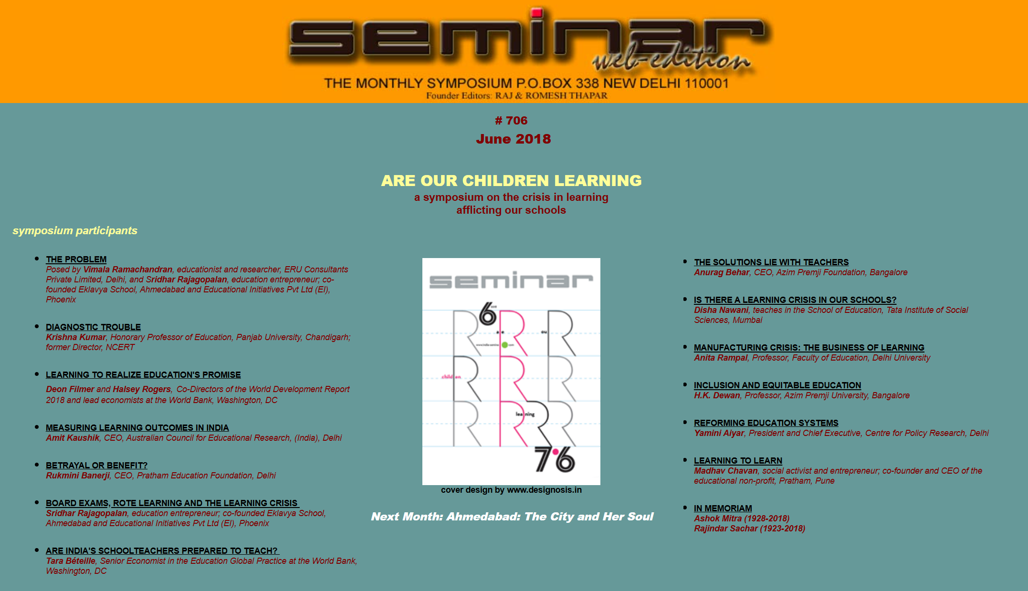
https://www.india-seminar.com/2018/706.htm

Slide 5
LeaRning level crisis- from INDIA-seminar 706
from INDIA-seminar 706

Slide 6
Outcome of schooling
Assessment – Learning
Minimum Learning level?
Assessment helps in learning?
Are nationalized tests the answer? (or the problem?)

Slide 7
Learning crisis? - The problem
What is expected out of 8, 10 or 12 years of schooling?
Grade appropriate learning?
Who gains most in schools? - social capital
Quality teachers?- who enters teaching profession? How are they trained?
Is India facing Learning level crisis ? Teaching level crisis?
Vimala Ramachandran and Sridhar Rajagopalan
Seminar, 706, June 2018

Slide 8
Learning crisis- Factors
Stratification of schools- by class :: Type of schools influences learning
Who you are , where you live, family income, social identity
Learning process:
Enablers; Empowerment of teachers; systemic changes meaningful teaching and learning
Purpose of assessments, and large scale testing?
Global attractiveness of standardized tests and large scale assessments.
Is large scale testing a tool to reform the system?
Vimala Ramachandran and Sridhar Rajagopalan
Seminar, 706, June 2018

Slide 9
NGOs and state and the role in learning
Short term mission programs-> basic reading/accelerated learning
School Monitoring-> help in learning
Scrapping no detention will miraculously change situation!

Slide 10
Learning to Learn- Madhav Chavan

Slide 11
Introduction
Annually 75,000 more engineering admission seats are vacant because of lack of jobs and this considered to be a result of poor education quality.
Largely colleges which have flourished in the last 25 years are private, but not many people discuss the private sector being responsible for poor quality of education.
This trend is not new. Earlier was seen in cities like Mumbai that elite, government aided Marathi medium schools started either losing students to English medium schools or themselves converted to English as a medium of instruction.

Slide 12
Statistics
In 2016 the DISE (District Information System of Education) reported 39% enrolment into private elementary schools, compared to 18% in 2007.
With increase opportunity, private schools started coming up rapidly in small towns and rural areas.
ASER found in 2017 that out of the 85% children enrolled in school or college, 40% worked for at 15 days in a month.

Slide 13
Skills from Education
There are certain skills that no matter what century we speak about are always important, that is skills like communication, problem solving and team work.
The problem is that schools never focused on outcomes of education, they only focused on the objective of getting good grades.
In 1990 the Jomtein Declaration had suggested that “Whether or not expanded educational opportunities will translate into meaningful development – for an individual or for society – depends ultimately on whether people actually learn as a result of those opportunities, i.e., whether they incorporate useful knowledge, reasoning ability, skills, and values.”

Slide 14
Policies and Assessments
Dakar Framework for Action in 2000 and the MDGs which were also set up in 2000 focused instead on quality of education to be measured through Universal Primary Education and enrolment and survival till Grade 5.
Pratham’s Educational Report was the first to measure learning outcomes quantitively through basic reading and maths skill (2005).
In 2006 the West did an Early Grade Reading Assessment.
Over the last 15 years, lot of similar tests have come about, while they are not comparable to one another, they all suggest that there is a poor status of basic academic outcomes.

Slide 15
World Development Report
The World Development Report of 2018 has suggested that we are in a learning crisis and has a three-point plan of action:
1) Assess learning to make it a serious goal, have the right metrics to measure it. 2) Use evidence on how to encourage learning in school. Build on good and strong teacher-learner relations and use the evidence for better learning effectively. 3) Align the entire system to work for learning, work through political and technical barriers. Focus on the deeper issues which prevent learning.

Slide 16
Figures in India
Today the Indian population is of 130 cr of whch there is a 13.5 cr enrolment in primary schools and 6.5 cr in upper primary.
In 2015, 38% of elementary school children went to private school of which the proportion in rural areas was 30% and urban areas was 57%.
There has been an increase in the number of people who have been joining school.
However, out of the 25 mil children who enter grade 1, only 40% go past grade 10.

Slide 17
Figures in India
Of the 15 mil who want to study further, only 7.5 mil graduate and among them almost 50% are not employed.
This does not mean that they are all unemployed, because often a lot of them are underemployed.
By govt report, 3% of those with school education are underemployed, 10% who are graduate and 18% who are above graduation level.

Slide 18
Current Education Needs
According to an article by Kai-Fu Lee who is an accomplished artificial intelligence innovator and computer scientist, in next 15-20 years half of the jobs are going to be replaced by machines.
By the way in which AI is progressing, the current schooling system is no longer adequate for the needs of the upcoming generations.
Schools were ideally meant to spaces for holistic development and not just focus on good grades, and now this will become more important than ever.
It is important that the schooling system makes changes within it, some fundamental qualities will remain like learning to listen and problem solving, but more importantly there is a need for qualities like learning to learn and being creative, for universal outcomes in the next phase of education.

Slide 19
Is there a Learning Crisis?- Disha Nawani

Slide 20
Introduction
Crisis, by the author of this paper is looked at as a moment of extreme calamity when crucial steps required to taken immediately to prevent catastrophe.
In the Indian context, this is related to both the quality of learning and the absence of learning among school children.
The crisis that presents itself in education in the Indian context is the lack of students being able to even perform basic literacy and numeracy skills.
The paper highlights two learning crises in India, one is of the importance of teachers and the role of public and private institutions in enabling learning.

Slide 21
Assessments and Results
The learning crisis in India is defined by assessment surveys like the Annal Status of Education Report (ASER) since 2005, which has been claiming that rural children going to schools are not equipped with age appropriate skills.
The nature of learning assess in these surveys is limited to having minimal knowledge in literacy and numeracy based on the age of the child.
While these tests do recognise differences in contexts among children, they don’t give them sufficient importance.

Slide 22
Assessments and Results
Assessment tools have limitations even if they are valid and reliable, and give only a partial picture with a certain fixed idea of what learning is.
Such assessments can only be used to assess abilities which can be objectively standardized. Plus, since data is collected within specific time periods and sufficient emphasis is not given to rapport building or allowing respondents to think with ease.

Slide 23
Assessments and Results
Such kind of hype and visibility also increases the pressure on teachers to teach for the sake of the test since that is the way in which they can show that they have ‘produced results.’
Finally, large scale assessments mostly revolve around the mechanics of testing, sampling design and efficacy on tools and not on the implications of learning, pedagogic interactions and role and importance of teacher and prior knowledge of students.

Slide 24
Implications of Assessments
Often, these tests end up focusing on the non-learning in government schools and make an assumption of private institutions being superior. This is a problematic stand point as it may:
1) underplay the extremely constrained and challenging backgrounds that students from rural populations come from.
2) the proposed solution of private schools being allowed to flourish without regulations given in the RTE has the scope of being misused.

Slide 25
Implications of Assessments
3) There is the undermining of welfare oriented public institutes and there is a flawed understanding that their dysfunctionality can be resolved by eliminating them.
4) The faith in the competence and motivation of under-trained and underpaid contractual teachers is misplaced and undermines the integrity of the teaching profession. 5) Finally, the implications of these tests is such that it reduces the meaning of learning to a minimum core where curriculum, pedagogy and assessment are geared towards only basic skills.

Slide 26
Social Stratification in India
Nonetheless, if children going to school are unable to pick up basic skills which form foundations of initial learning, it is a concern.
But the blame cannot be given to simple cause and effect relations, there are more systematic reasons that one must examine.
The four-tired division in India is mainly: 1) the top tier which is elite schools and are unaided private schools. 2) The next layer is the government central schools and quality private aided or unaided schools. 3) The third tier are private aided or unaided schools which are of average quality. 4) Finally the fourth category are local body schools and low cost private schools.

Slide 27
Implications of Stratification
There is a direct connection between socio-economic backgrounds and the kind of accessibility to schools and the kind of resources and teachers that exist within those spaces.
Schools which have poor infrastructure significantly reduce the desirability of learning and therefore impedes learning.
This would mean that the learning crisis is not true across all sections of the society.

Slide 28
General Problems of Education System
That being said, students from both backgrounds are taught to understand learning as memorizing content.
Unlike the manner in which schools create a monopoly over the process of learning, learning takes places outside of the four walls as well.
Indian schools affiliated with the central board or state boards confine learning to text books.

Slide 29
General Problems of Education Systems
The other evil along with text books is the objective assessment practices in schools.
Learning become synonymous to getting marks in examinations, which was a legacy of the colonial education system.
The manner of examinations puts stress on students and ability to memorize is rewarded.

Slide 30
General Problems of Education Systems
Eventually the centre proposed a school based continuous comprehensive evaluation which broadened the scope of learning and placed the teacher in the most suitable position to assess the child.
With this came the addition in the RTE Act to not detain any child in a class till completion of elementary schooling, which was ridiculed by policy makers, parents and teachers, since they believed it promoted a carefree environment.
The policy was eventually reversed and board exams were reintroduced as early as Grade V.

Slide 31
Suggestions for Changes
It is necessary to recognize that a singular heterogenous textbook cannot encapsulate all the diversity within the children. This jeopardizes their learning.
It should also be kept in mind that children often also learn in other different ways which should be catered to.

Slide 32
Suggestions for Change
The National Curriculum Framework in 2005 was an important document which linked the problem with dropouts to the inequality within the education system.
It mentioned the failure of the current curriculum and a need to have a system that acknowledges agency of the child and creates a space where the child can learn without fear.
There are also solutions proposed towards shifting the responsibility towards the institutions.

Slide 33
Suggestions for Change
Low cost private schools have been aggressively making their presence felt and claiming that they are doing a better job that government schools.
Rather than eliminating government schools, it is important to find system changes that will improve them.
At the end of it, in the current states that schools are in, is not enough.
All suggestions that have been mentioned, will have a limited impact in making significant changes.
Meaningful change would require breaking the current system of education, which is currently linked with the stratified social structure and de-link marks obtained to better jobs.

Slide 34
Low-learning traps & teacher-centric solutions

Slide 35
Betrayal or Benefit? - Rukmini Banerjee
The paper examines the extent of learning at the end of elementary education, as well as future educational prospects
With policy focus shifting towards secondary education, it is important to understand the capabilities of students transitioning from elementary to secondary school

Slide 36
About the student body
Approx. 25 million children in each age category
High growth rate of number of 8th graders
Trend of declining age in 8th graders
Increase in enrollment in private schools
No. Of 8th graders in 2006-07 | 12 million
No. Of 8th graders in 2016-17 | 22 million

Slide 37
Variance in enrollment patterns
Data collected from two districts – Hardoi (Uttar Pradesh) and Sambalpur (Odisha) - by tracking 8th graders for 18 months
HARDOI | SAMBALPUR
- High number of elementary schools (227) | - Fewer elementary schools (98)
- Small proportion of secondary schools (56) - Most of these are private schools | - Higher proportion of secondary schools (33) - Mostly government schools
- 63% children enrolled in govt. schools | - Almost all children in govt. Schools
- 40% people dropped out after 8th grade | - 4% dropped out after 8th grade

Slide 38
Attendance
Each school was visited twice
In Hardoi, 60% of the enrolled students were absent on both days (in govt and private schools), whereas more than 60% were present in Sambalpur
Context-dependent variances in enrollment as well as attendance in upper primary grades need to be understood to provide better secondary education

Slide 39
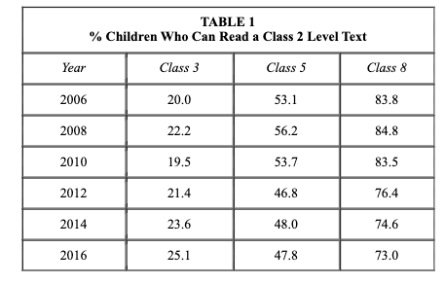
Acquisition of Learning in the 8th grade
"Each additional year of education is adding less and less for each successive cohort"
A 3-year cohort study in districts Nalanda (Bihar) and Satara (Maharashtra) in which 6000 upper primary students were tracked, found that if children did not already have foundational reading and arithmetic skills, they were unlikely to acquire them in the subsequent years.

Slide 40
The Nalanda-Satara study also found that more than half of the students remained at the same level of learning in their next school year.
These students were more likely to be female and from poorer and less educated families
Transition to secondary school was lower among students lacking foundational reading and arithmetic skills
Similar data found in Nalanda-Satara study as well as Hardoi-Sambalpur study --- this suggests that despite difference in contexts, upper primary students acquired learning that was well below the level of lower primary standards

Slide 41
Key Challenges
Considerable number of class 8 graduates lack basic numeracy and literacy skills
As time passes, gaps in learning acquisition keep widening when better-performing students move further and further ahead
Expenditure on schooling continues while minimal value is obtained by low learning students

Slide 42
Way forward
Further research on schooling trends
Re-imagining assessment formats
Paper-pencil tests might not be the most appropriate given that a high percentage of students have difficulty reading
Reporting of test results should be such that district education officials can take action
Re-thinking the curriculum
Current curriculum seen to be "over-ambitious"
Need for in-depth discussion on the content, pace, sequence, and relevance of the curriculum
Operationalise the capabilities a child should have acquired after completion of compulsory education

Slide 43
The Solutions lie with Teachers - Anurag Behar
The paper argues for a "pro-teacher stance" to address the low learning levels encountered in education
There exists a remarkable gap in perception and reality of teacher of truancy.
This study found that 2.5% of teachers were absent from schools, as opposed to the perceived 25 – 50%.
"There is a staggering difference between the reality of public schools in India where 2.5-4.5% teachers are truant, versus the imaginary world of public schools that exists in the psyche of a vast number of people, where 25-50% teachers are truant."

Slide 44
The perception propagates the narrative that the fundamental problem with education in India is its teachers.
Why is this narrative problematic?
Solutions to the problem of "bad" teachers are usually along the lines of controlling teachers because they cannot be trusted to their job effectively if left on their own
Teachers become scapegoats while actual issues with the education system are masked/ignored/attributed to imaginary truancy
Erases the complexity of problems in education in India
A "pro-teacher stance" (PTS) is an approach which analyses teachers' challenges and circumstances

Slide 45
Challenges of the Public School Teacher
Most students socio-economically disadvantaged backgrounds, many of them first generation school goers, and often from homes in acute poverty
Most teachers have to handle multiple grades and multiple subjects at the same time
Schools lack adequate infrastructure
Teachers usually do not encounter the spirit of the NCF are only faced with the content-heavy syllabus stipulated by the NCF. This fosters a culture of rote, and a rather mechanical approach to educational processes
Poor administrative culture
Teachers are not adequately prepared for their roles
Weak academic support and ineffective professional development opportunities

Slide 46
Possible Solutions
Recruiting an adequate number of teachers
Basic infrastructure in all schools
Adequate number of rooms, electricity, and toilets with running water
Providing extra support to students (that is beyond the scope of what the teacher can provide)
Extra meal, better meal quality, resourcing school clusters to social workers
Improvement in textbooks and exams such that the teachers' contexts are accounted for
Completely changing pre-service teacher education to high quality multidisciplinary, 4-year integrated education programmes
CPD

Slide 47
Continuing Professional Development (CPD)
Continually enhancing the capacity of existing teachers
Increases motivation and engagement of teachers
BASIC PRINCLIPLES OF CPD
- Explicitly distinct from practices of the past
- High capacity team (20 –70 members) of teacher educators in each district
- Curricular framework to provide guidance to the CPD programme
- Multimodular, i.e., long and short workshops, online sessions, exposure visits, in-school support, etc.

Slide 48
- Logistically convenient
- Sustained efforts to foster local peer learning networks
- Of interest and relevance to teachers
- Teacher is in charge of their own developmental trajectory

